Slide 1
Epi 510: Introduction to Stata I

Slide 2
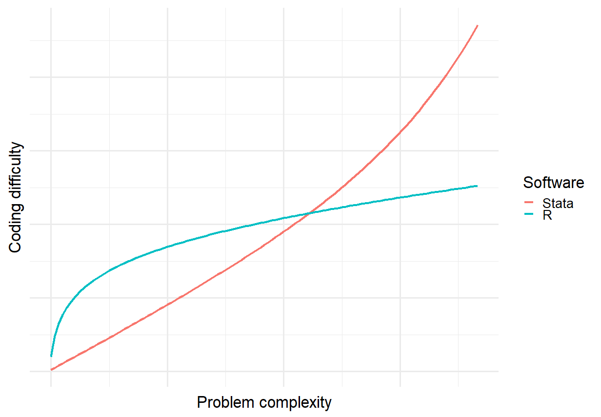

Slide 3
Comparing Stata & R: Usability
 | Base R | R with libraries | Stata
Intuitiveness to non-coders* | Very weak | Variable | Strong
Intuitiveness to coders* | Variable | Variable | Variable
Official documentation | Very weak (nearly useless) | Variable (usually terrible) | Very strong
Support | Community | Community | Professional
Software quality (e.g. stability) | Strong | Very variable | Very strong
Compatibility between installations & versions | Strong | Weak | Strong
Syntax consistency | Moderate | Very weak | Very strong
"Guardrails" | Few | Few | Many
*
Subjective

Slide 4
Comparing Stata & R: Capability
 | Base R | R with libraries | Stata
Extensibility | Very strong |  | Moderate-strong
Availability of extensions | Very strong |  | Moderate
Flexibility | Very strong | Very strong | Weak
IO capabilities | Weak | Very strong | Moderate
Data management capabilities | Strong | Very strong | Strong
Analytic capabilities | Weak | Very strong | Strong
Graphing capabilities | Weak | Very strong | Strong

Slide 5
Notable strengths of Stata & R
R | Stata
Strong user community Extensive libraries Object transformability Rapid development and incorporation of new methods Spatial data & analyses Machine learning | Intuitive & consistent syntax Support & documentation Longitudinal data & analysis Time series data & analysis Robust estimation
Notes:
Spatial work – in R not ArcGIS (any classes?)

Slide 6
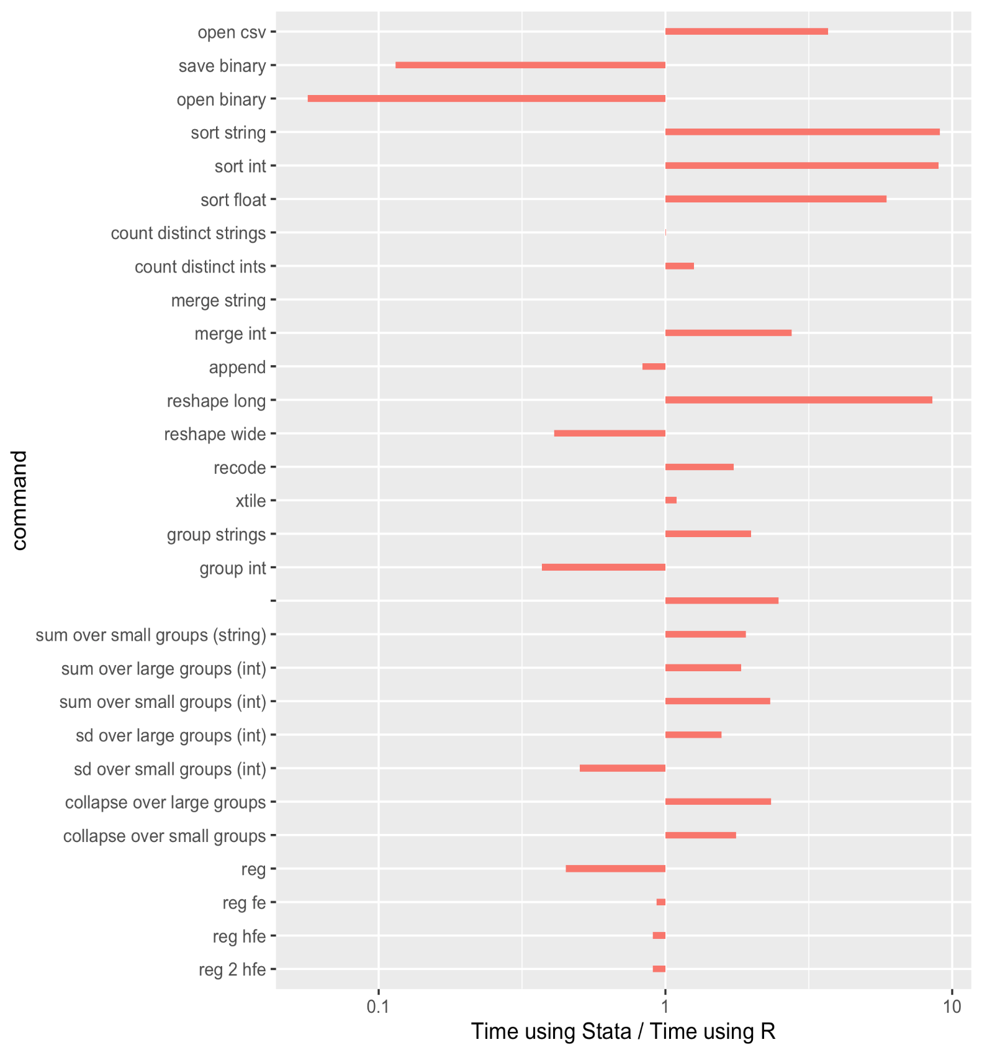
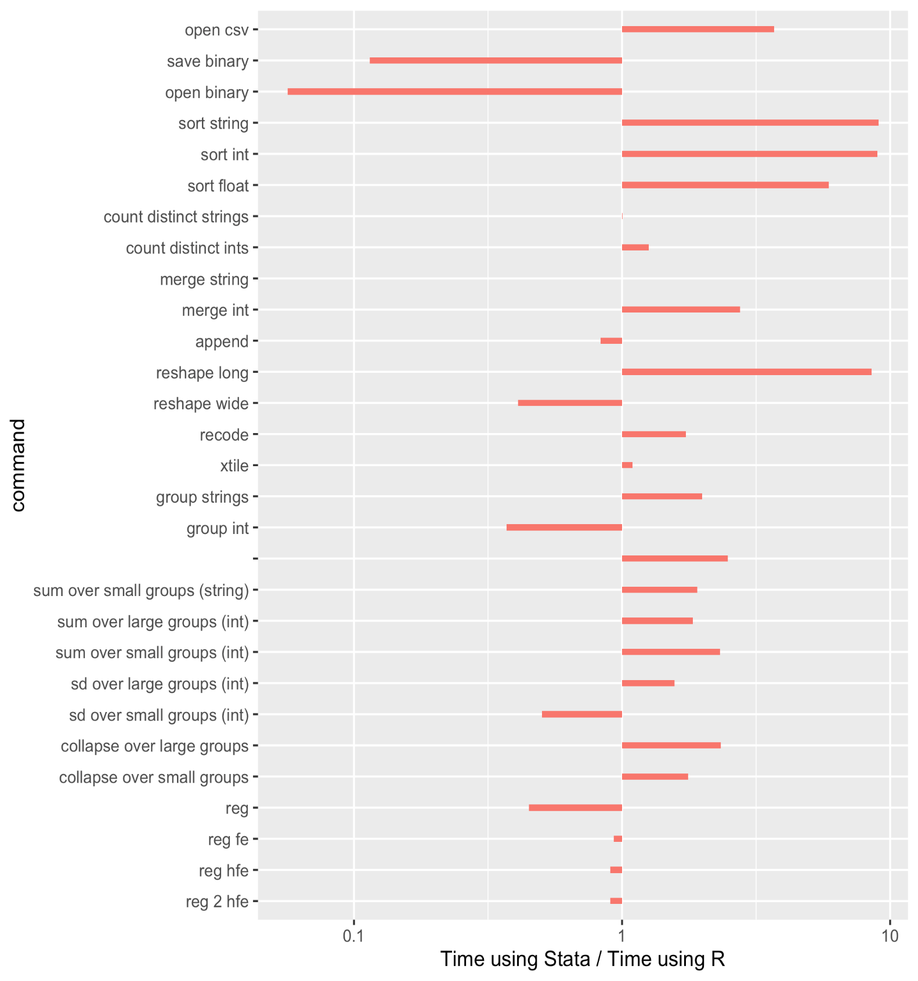
Benchmarking: Stata vs R
https://github.com/matthieugomez/benchmark-stata-r

Slide 7

Powerful general purpose statistical software package

Slide 8
Why ?
Language Data management
Analytic capability
Graphics
Documentation
Notes:
language = agile, powerful & intuitive

Slide 9
Stata basics

Slide 10
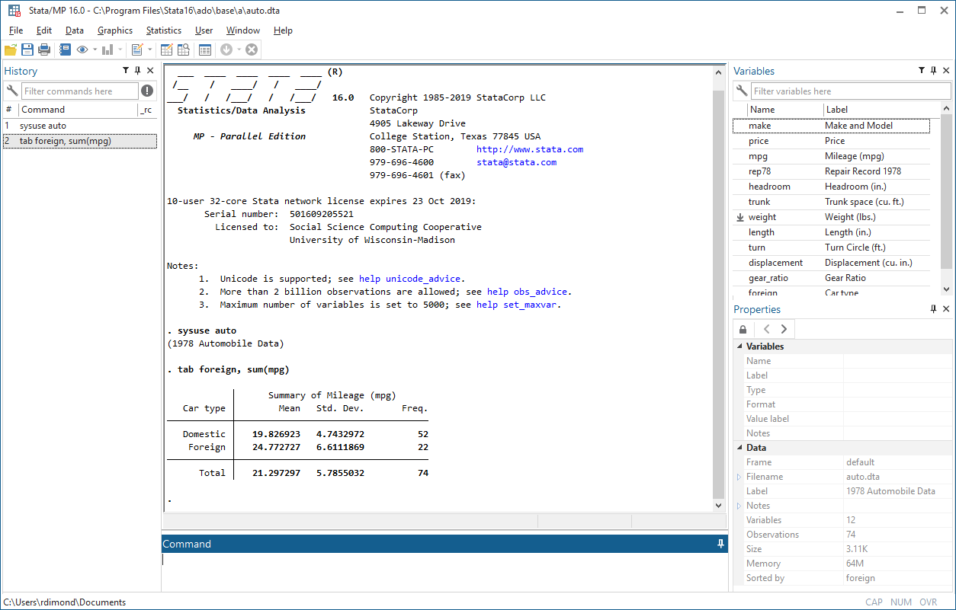
Drop-down menus & toolbar
<
Variables window:
list of variables in current dataset
Review (History) window:
log of commands
Results window:
displays commands, output & error messages
Command window:
where you type commands interactively

Slide 11
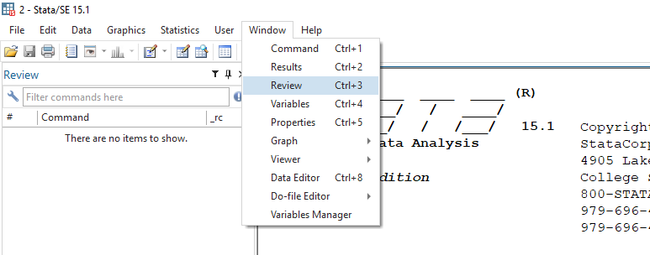
Where did the review window go?
Stata 16: named changed from "Review" to "History" window
Seems to not always be displayed by default

Slide 12
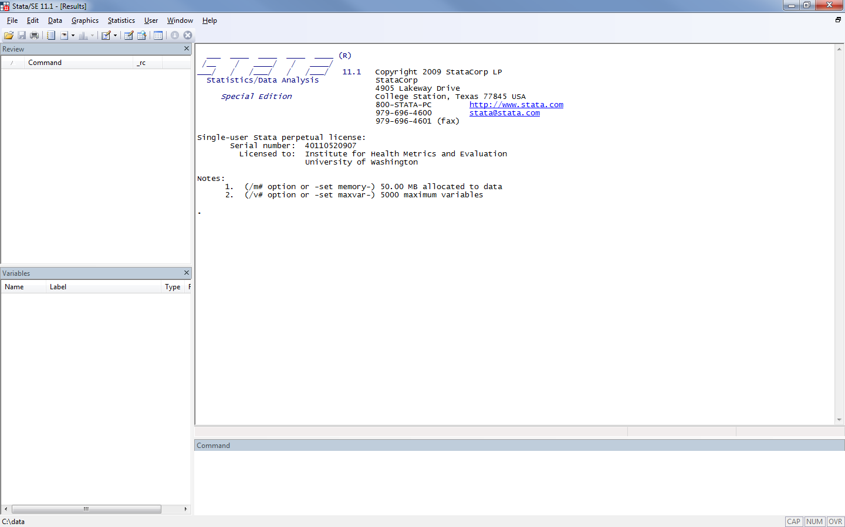
Drop-down menus & toolbar
<
Review (History) window:
log of commands
Results window:
displays commands, output & error messages
Variables window:
list of variables in current dataset
Command window:
where you type commands interactively

Slide 13
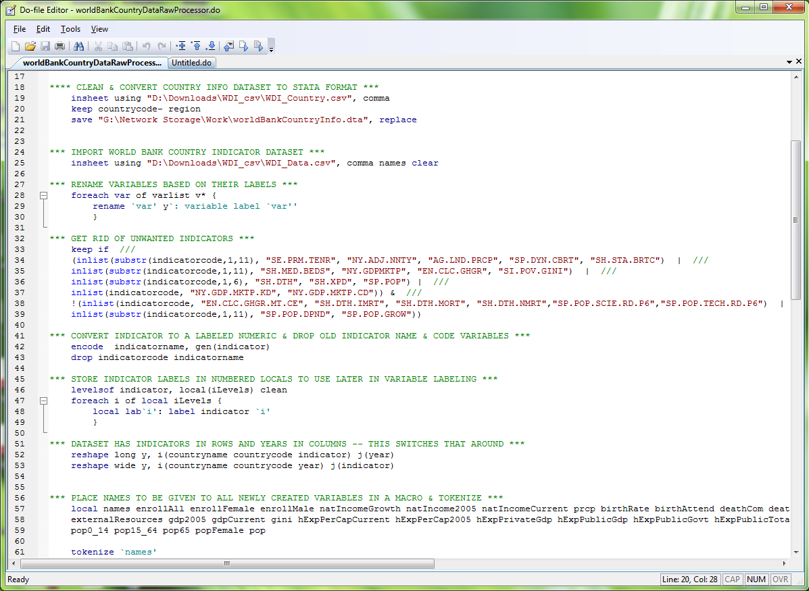
Use drop-down menus
Run commands from a script (aka 'do-file')
Type commands interactively
/
<

Slide 14
When to use which?

Slide 15
 | Pros | Cons | Use when
Drop-down menus | Easy Good learning tool | Slow Scripting: Extra step May lose commands Limited functionality | Learning Building tricky commands (e.g. graphs)
Notes:
Dropdown menus are helpful for learning, but its slower

Slide 16
 | Pros | Cons | Use when
Drop-down menus | Easy Good learning tool | Slow Scripting: Extra step May lose commands Limited functionality | Learning Building tricky commands (e.g. graphs)
Command line | Fast Good for figuring out commands | Scripting: Extra step May lose commands Bad for blocks of code | Figuring out code Conversing with data
Notes:
Command line is good for figuring out commands

Slide 17
 | Pros | Cons | Use when
Drop-down menus | Easy Good learning tool | Slow Scripting: Extra step May lose commands Limited functionality | Learning Building tricky commands (e.g. graphs)
Command line | Fast Good for figuring out commands | Scripting: Extra step May lose commands Bad for blocks of code | Figuring out code Conversing with data
.do files | Fast Perfect trail Repeatable Good for figuring out blocks of code | Annoying for sorting out commands | Doing formal data mgmt. & analyses Working in blocks of code
Notes:
Use do files when doing formal data management or working with blocks of code.

Slide 18
!
Anything that matters must end up in a do-file

Slide 19
Notation

Slide 20
Fixed-width font: Stata command
Italic: Placeholder within a command (e.g. varname means 'type a variable name')
Enclosed in square brackets: [optional]
Enclosed in curly brackets:
{you|must|choose|one|option}
Underlined: minimum abbreviation (caution!)
Notes:
Don’t abbreviate too much because it’s hard to look at after the fact OR abbreviate to a readable code (ex: gen for generate instead of just g)
Abbreviating commands is acceptable
Abbreviating variable names is bad practice

Slide 21
help datatype

Slide 22
How Stata stores data

Slide 23
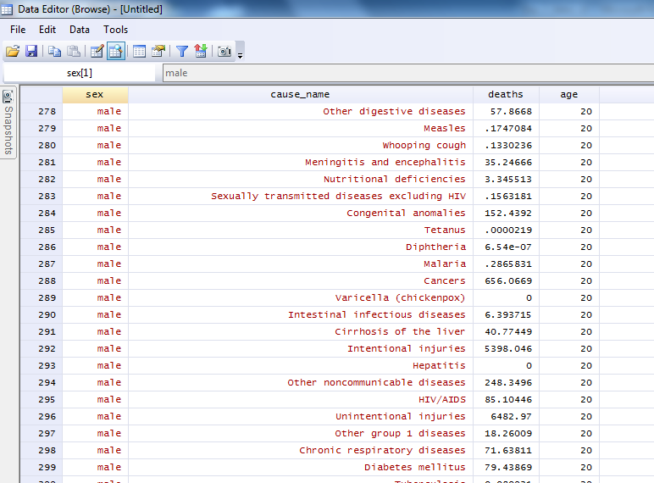

Slide 24
Variable types
Numeric
String
Numeric
String
Numeric
String
Type | Minimum | Maximum | Bytes
byte | -127 | 100 | 1
int | -32,767 | 32,740 | 2
long | -2.15 x 10⁹ | 2.15 x 10⁹ | 4
float | -1.70 x 10³⁸ | 1.70 x 10³⁸ | 4
double | -8.99 x 10³⁰⁷ | 8.99 x 10³⁰⁷ | 8
Type | Maximum length | Bytes
str1 | 1 | 1
str2 | 2 | 2
… | . | .
… | . | .
… | . | .
str244 | 244 | 244
help datatype
Notes:
Floating point precision is generally ok for public health work
Don’t have factor variables, but something similar

Slide 25
compress converts variables to most efficient storage type
help compress

Slide 26
Missing
Numeric:
. (also .a, .b, … , .z)
Infinitely large value
String:
""
help missing
Notes:
Missing numerics indicated as . (or specialty .a, .b, etc.). The specialty missing numerics can be used to indicate someone refused to answer, data entry error, no answer, etc. Indicated different reasons for missingness.
When using greater than in stata, be careful…?

Slide 27
Using Stata as a calculator: display & mathematical operators
Notes:
Everything you do in stata has to be a function, so to use as calculator have to type display

Slide 28
Mathematical operators
NB. parentheses indicate order of operations
Operation | Symbol
Addition | +
Subtraction | -
Multiplication | *
Division | /
Exponents | ^
help operator

Slide 29
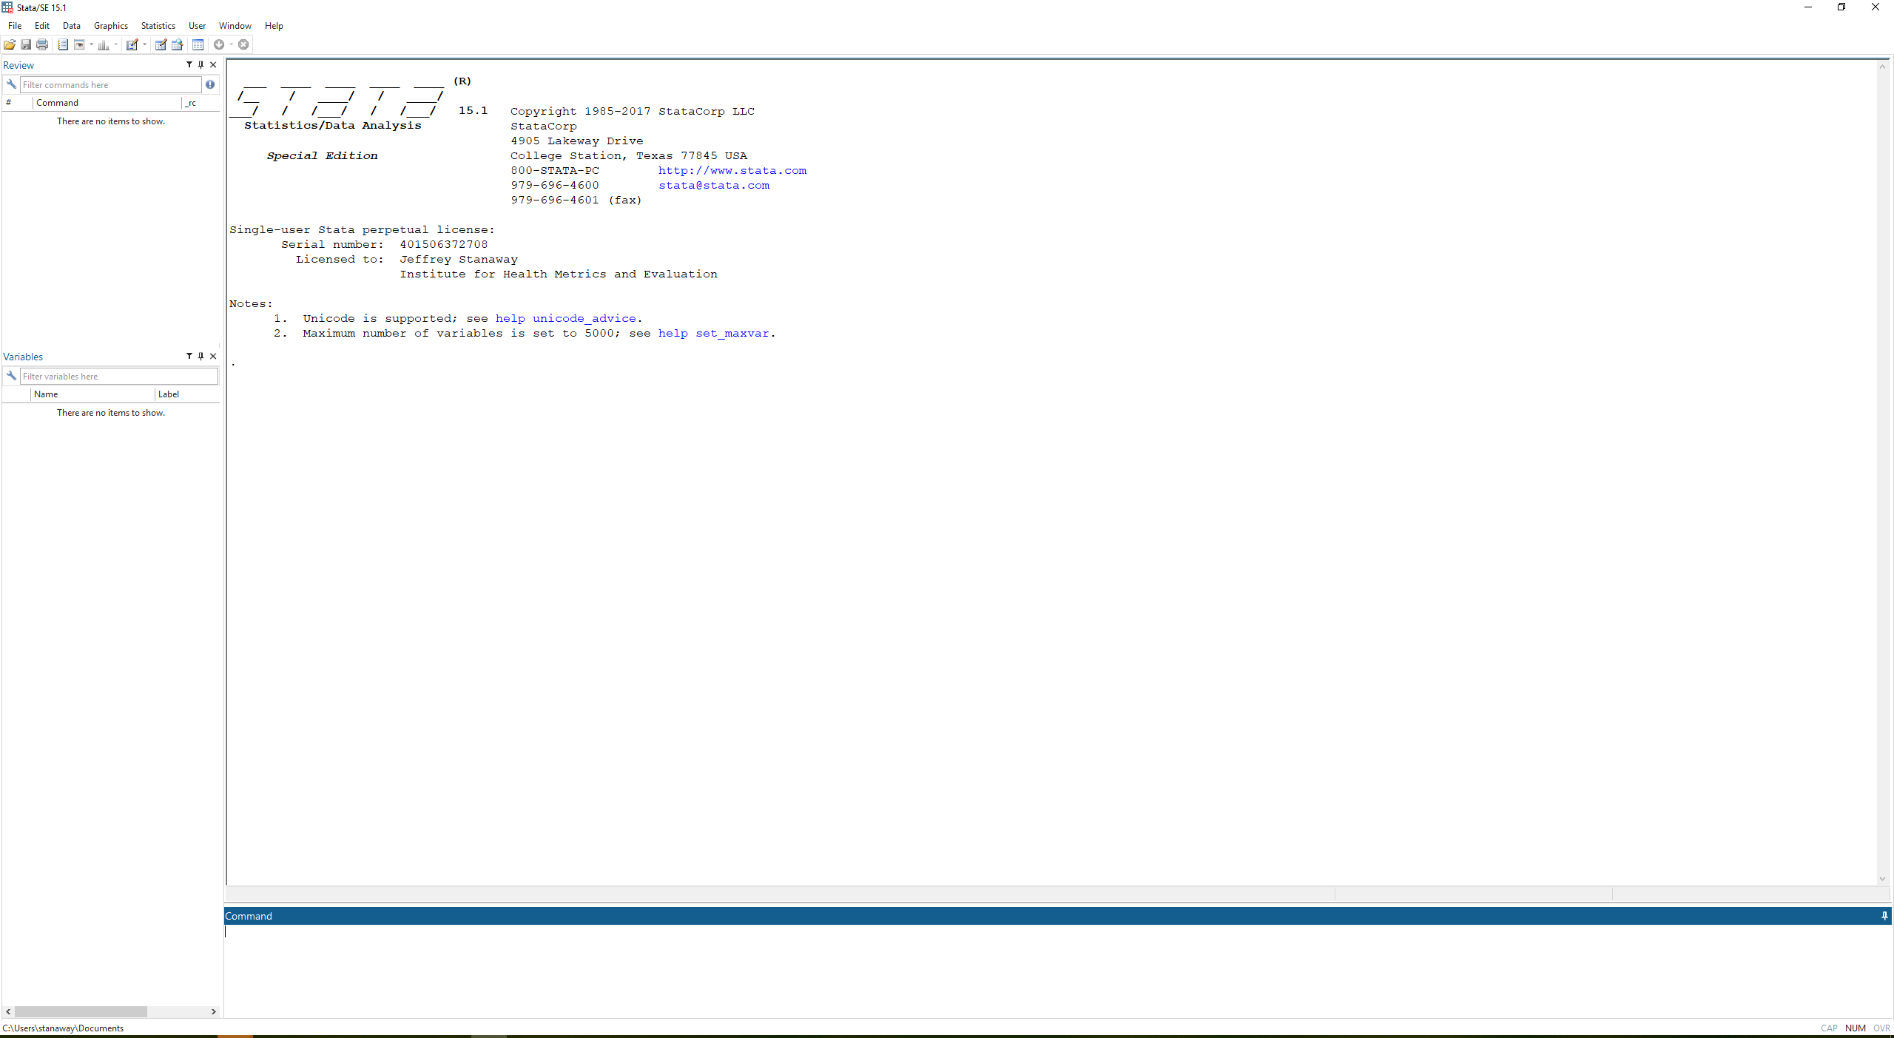
display 2+2
help display

Slide 30
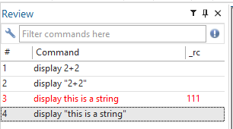
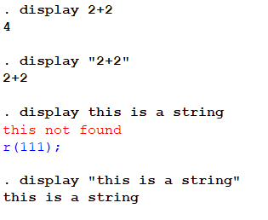
display "2+2"
help display
Notes:
“” indicates string so stata won’t evaluate, it’ll just display text

Slide 31
display this is a string
help display

Slide 32
display "this is a string"
help display
Notes:
Can click on error message code

Slide 33
display "2 + 2 = " 2+2
help display

Slide 34
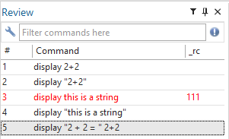
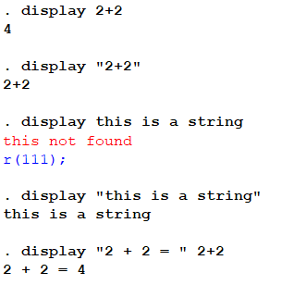
help display

Slide 35
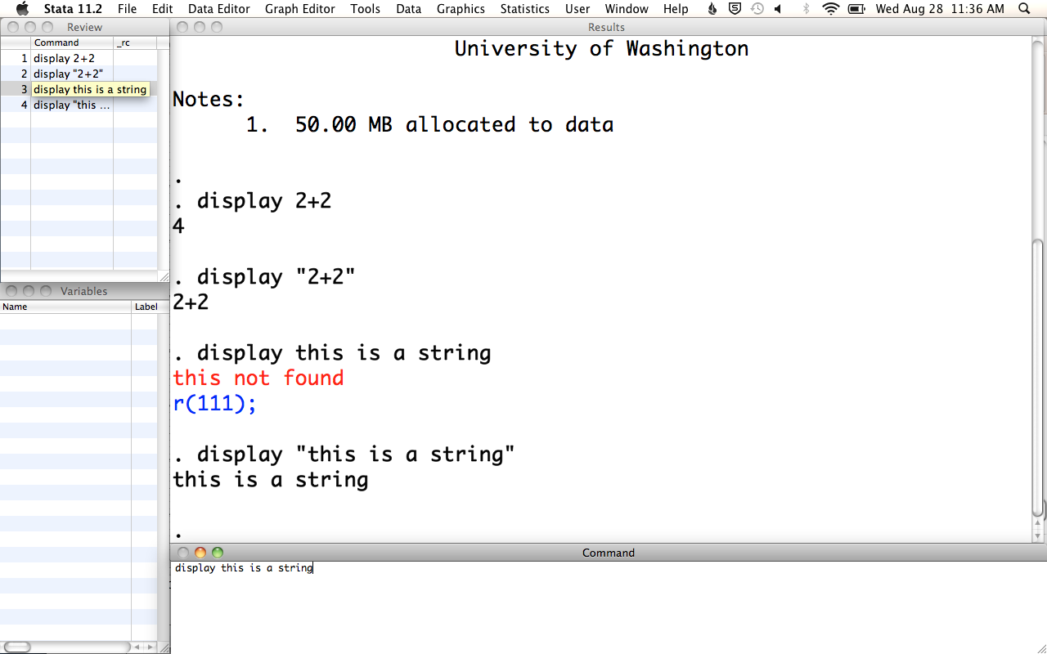
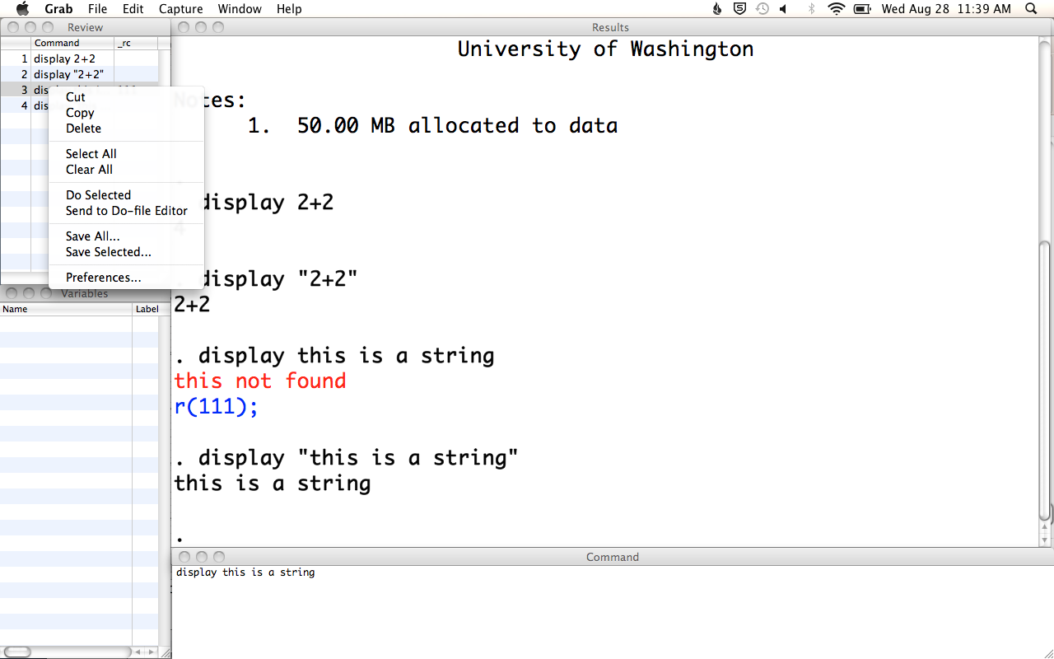
Retrieving past commands

Slide 36
Retrieving past commands
Or, scroll through past commands using
Page up & Page down*
*
fn & fn for Mac users

Slide 37
scripts
“do-file” in Stata
text file with .do extension
series of Stata commands

Slide 38
Why use “do-files”?
Complex tasks
Reproducibility
Make changes
Record
Notes:
Completing involved tasks
Almost everything you do will be more than a few lines of code.
Reproducibility
You (and others) can repeat your analytic technique on different data
Documentation
Hmm, what regression did I run on that dataset I analyzed two months ago?
Ease of making changes
You can perform different analyses with simple changes and easily solve mistakes you’ve made.

Slide 39
!
Anything that matters must end up in a do-file

Slide 40
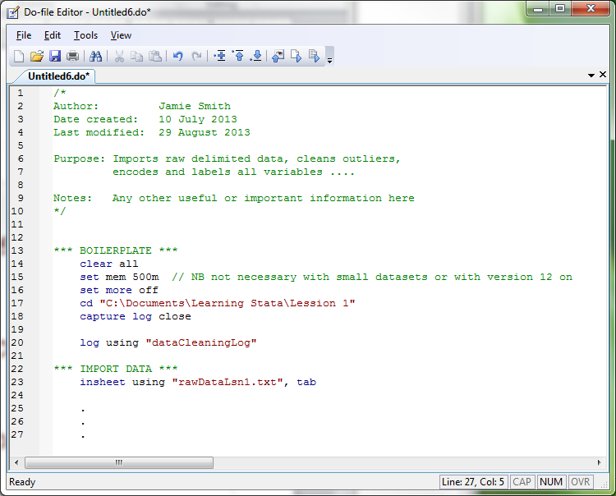
/
<
Header
/
<
Boilerplate
/
<
Your code

Slide 41
Commenting code
Organizational cues (section headers)
Explain the purpose of code
Explain the mechanics of code
Comment liberally.

Slide 42
The only format usable on the command line
* This line is a comment
// This line is also a comment
display 2+2 // comment @ the end of a line
display 2 /// command continues +2
/* Multiline comments can be written between these delimiters */
/
<
help comments
Notes:
* can’t be used mid-line, it has the start with *
// allows you to comment at end of code or at start
/// continues command on next line
* is only usable comment style in command line, whereas the others all work in do file

Slide 44
Run do-files from
do-file editor
command line
another do-file

Slide 45
Do
/
<
Notes:
Command or function + r – hotkey

Slide 46
Or, type
do “doFileName.do”
at the command line or in another do-file

Slide 47
Getting help

Slide 48
1. help command
2. Stata manuals
3. Stata listserv (www.stata.com/statalist/)
4. Stata technical services
5. IDRE @ UCLA (www.ats.ucla.edu/stat/stata/)
6. Web search
7. Ask

Slide 49
Getting data into Stata

Slide 50
use load a Stata-format (.dta) dataset
help use
Notes:
Use .dta files unless you are sharing across platforms

Slide 51
use filename [, clear]
use vipcls.dta, clear
Notes:
Clear is optional – if you have a dataset open, it will clear out current data

Slide 52
set more off
cd "C:/epi510/stata/data"
use "vipcls.dta", clear
compress
Notes:
Set more off = pours out all output instead of by page, optional pending preference
Cd = setting working directory

Slide 53
A note about paths

Slide 54
cd "C:\epi510\stata\data"
use "vipcls.dta", clear
=
cd C:/epi510/stata/data
use vipcls.dta, clear
Notes:
Only time you need to use quotes is if there’s a space in filepath name – otherwise you can use quotes or not use quotes
/ for mac

Slide 55
Quotes around paths/filenames when they contain spaces
“\” is Windows only; “/” is universal
Notes:
----- Meeting Notes (9/5/13 16:04) -----
fix mortality

Slide 56
Questions?

